Slide 1


Social Buzz
Data Report

Slide 2


Today's agenda
Project recap
Problem
The Analytics team
Process
Insights
Summary

Slide 3

Social Buzz has reached over 500 million active users each month. They have s scaled quicker than anticipated and need the help of an advisory firm to oversee t their scaling process effectively.
Broadly these following task need to be undertaken:
-An audit of their big data practice.
-Recommendations for a successful IPO.
-An analysis of their content categories that highlights
the top 5 categories with the largest aggregate popularity.
Project Recap

Slide 4

Unstructured over 100,000 pieces of content, ranging from text, images, videos and GIFs are posted.
Problem
Due to their rapid growth and digital nature of their core product, the amount of data that they create, collect and must analyze is huge.
Help them to understand how the world's biggest companies manage the challenges of big data.
Analysis of their content categories that highlights the top 5 categories with the largest aggregate popularity.

Slide 5




Rohit Kumar Singh
Data Analyst
The Analytics team
Marcus Rompton
Senior Principal
Andrew Fleming
Chief Technical Architect

Slide 6
Data Analysis
Data Collection and Understanding
Process
1
-used given data model to find relevant data and correlation between them.
Data Cleaning
2
-removed data with blank values
-removed unnecessary columns form the data set
Data Modelling
3
-using MYSQL data where joined on common columns to prepare a clean spreadsheet.
4
-analysis of Content Category
-factors affecting Categories score
Data Insights
5
-visualization provided below.

Slide 7
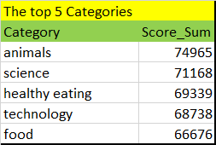

Content related to animals, science and healthy eating has the highest popularity!
Insights

Slide 8
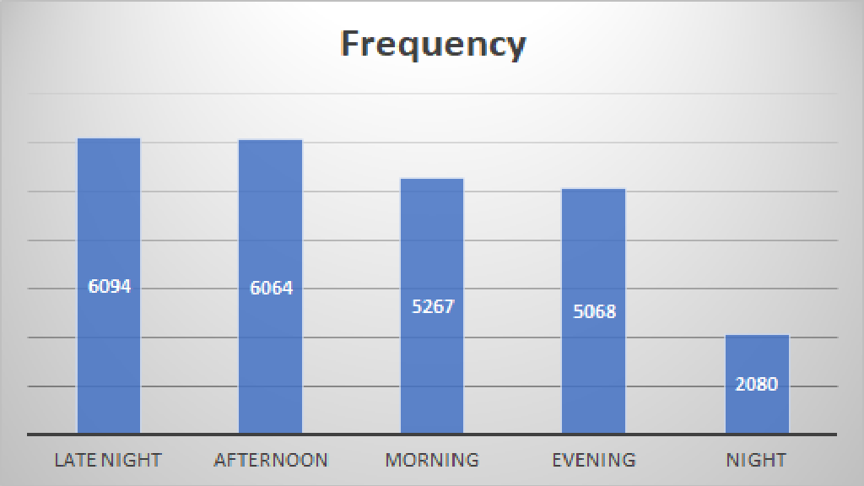
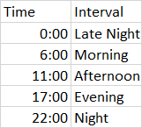
Most activity in Late Night and Afternoon.

Slide 9
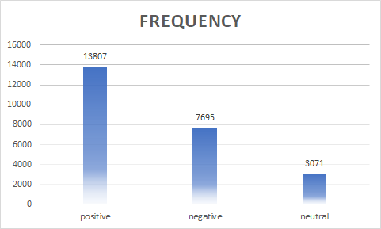
56% of User Interactions were positive 31% of User Interactions were negative Rest were neutral

Slide 10

Social Buzz top category are animals, science, healthy eating, technology and food.
Late Night and Afternoon has peak user reaction. Prime time for premium advertisements.
Summary
Positive User experience sits at 56%. It can be drastically improved for User retention period.

Slide 11
Thank you!
ANY QUESTIONS?

